Slide 1
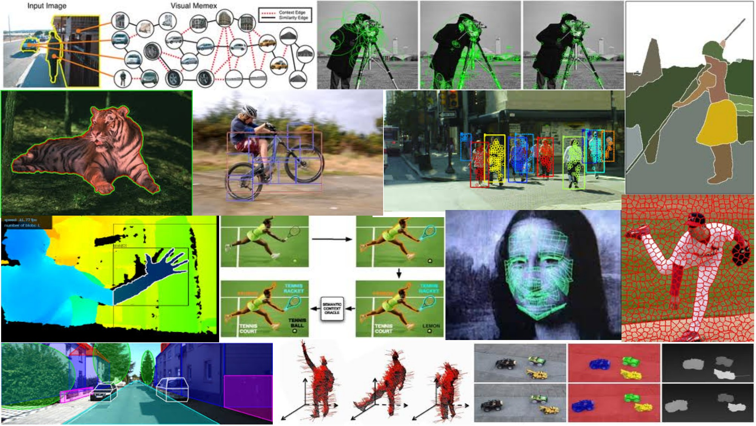
Fitting: Voting and the Hough Transform April 24th, 2018
Yong Jae Lee
UC Davis

Slide 2
Announcements
PS0 grades are up on Canvas
PS0 stats:
Mean: 93.38
Standard Dev: 7.86

Slide 3
Last time: Grouping
Bottom-up segmentation via clustering
To find mid-level regions, tokens
General choices -- features, affinity functions, and clustering algorithms
Example clustering algorithms
Mean shift and mode finding: K-means, Mean shift
Graph theoretic: Graph cut, normalized cuts
Grouping also useful for quantization
Texton histograms for texture within local region
Slide credit: Kristen Grauman

Slide 4
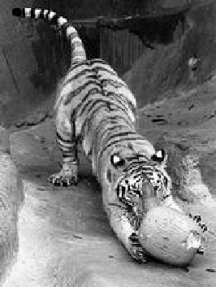
Recall: Images as graphs
q
w_{pq}
w
p
Fully-connected graph
node for every pixel
link between every pair of pixels, p,q
similarity w_{pq} for each link
similarity is inversely proportional to difference in color and position
Slide by Steve Seitz

Slide 5
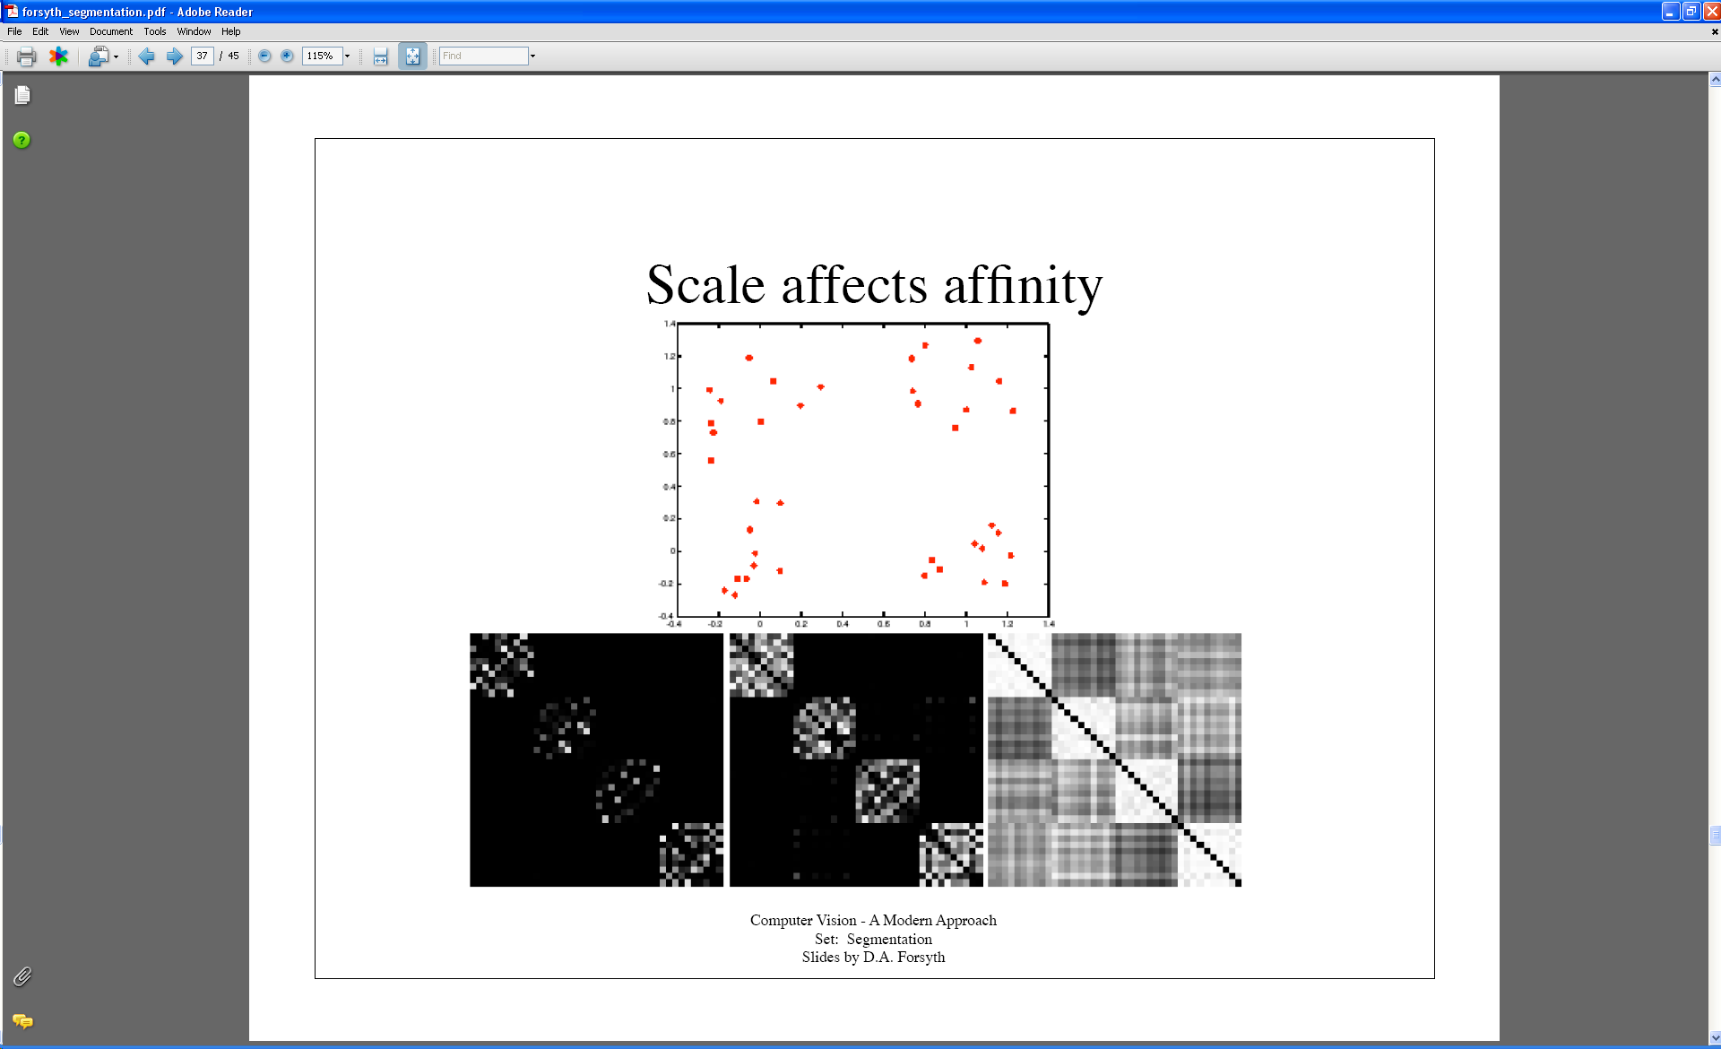
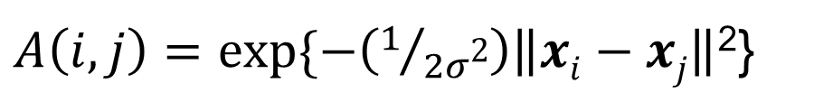
Last time: Measuring affinity
Points x₁…x₁₀
40 data points
40 x 40 affinity matrix A
x₁
.
.
.
x₄₀
Points x₃₁…x₄₀
x_{1 . . .} x₄₀
$A\left(i,j\right)=exp⁡\{−\left(1/{2σ\text{2}}\right)\left\|xi−xj\right\|$²}
What do the blocks signify?
What does the symmetry of the matrix signify?
How would the matrix change with larger value of σ?
Slide credit: Kristen Grauman

Slide 6
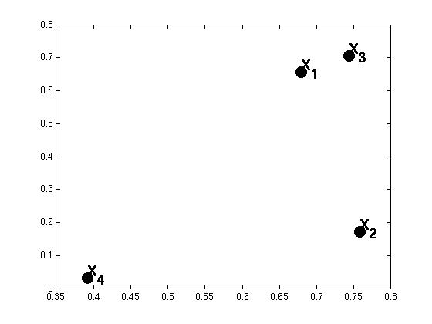
Example: weighted graphs
Suppose we have a 4-pixel image
(i.e., a 2 x 2 matrix)
Each pixel described by 2 features
Feature dimension 2
Feature dimension 1
Dimension of data points : d = 2
Number of data points : N = 4
Kristen Grauman

Slide 7
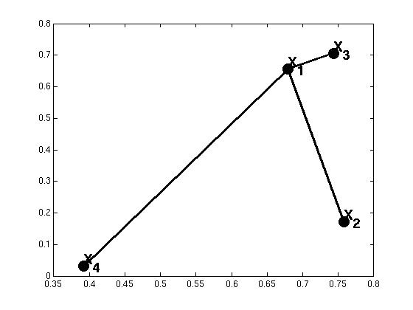

Example: weighted graphs
Computing the distance matrix:
D(:,1)=
0.01
D(1,:)=
(0)
0.24
0.01
0.47
0.24
0.47
for i=1:N
for j=1:N
D(i,j) = ||x_{i}- x_{j}||²
end
end
Kristen Grauman

Slide 8
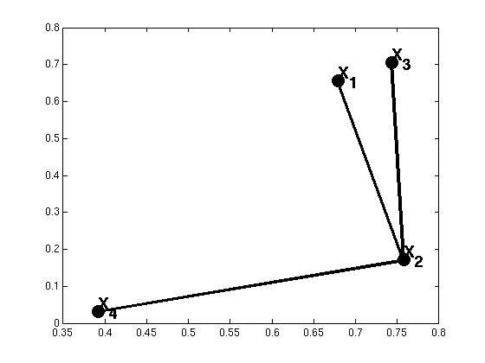
Example: weighted graphs
Computing the distance matrix:
D(:,1)=
D(1,:)=
(0)
0.24
0.01
0.47
0.29
0.24
(0)
0.29
0.15
0.24
0.15
for i=1:N
for j=1:N
D(i,j) = ||x_{i}- x_{j}||²
end
end
Kristen Grauman

Slide 9
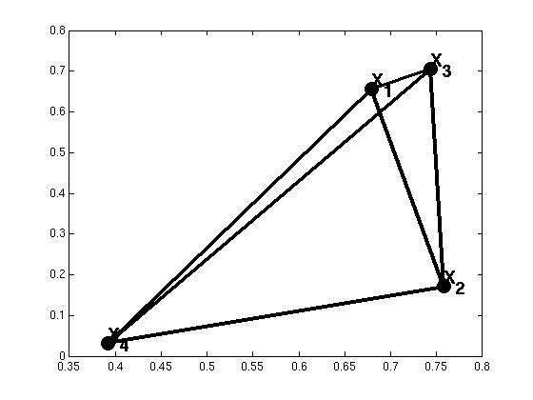
Example: weighted graphs
Computing the distance matrix:
for i=1:N
for j=1:N
D(i,j) = ||x_{i}- x_{j}||²
end
end
N x N matrix
Kristen Grauman

Slide 10
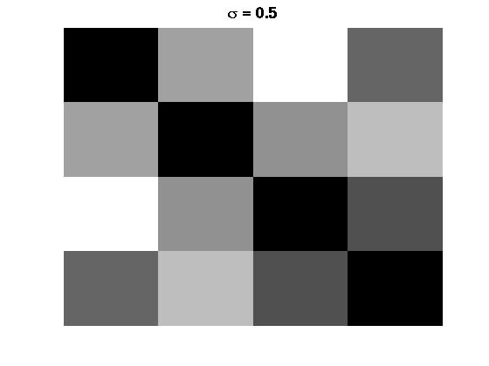
Distances→affinities
Example: weighted graphs
D
A
for i=1:N
for j=i+1:N
A(i,j) = exp(-1/(2*σ^2)*||x_{i}- x_{j}||²);
A(j,i) = A(i,j);
end
end
for i=1:N
for j=1:N
D(i,j) = ||x_{i}- x_{j}||²
end
end
Kristen Grauman

Slide 11
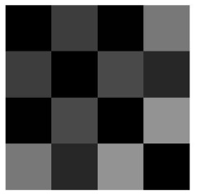
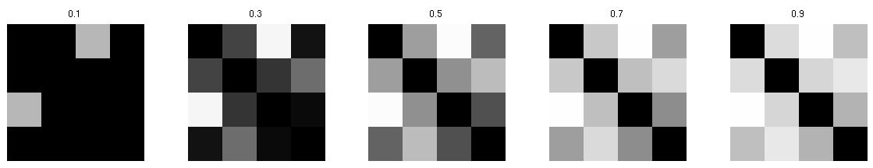
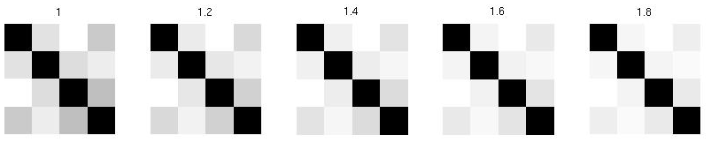
Scale parameter σ affects affinity
Distance matrix
D=
Affinity matrix with increasing σ:
Kristen Grauman

Slide 12

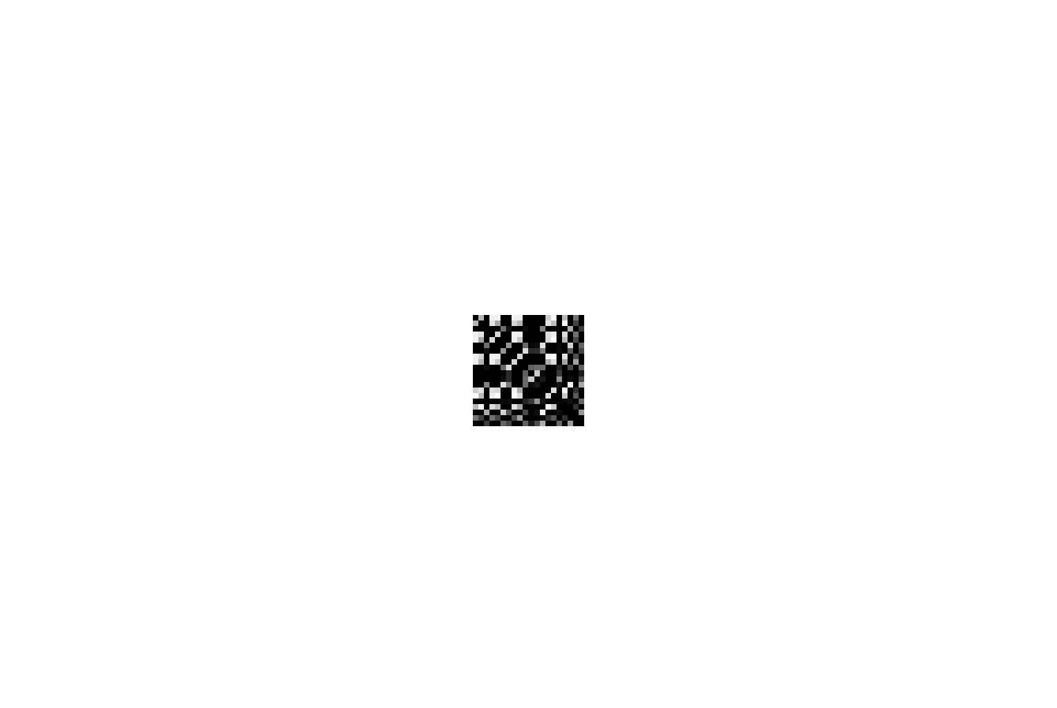
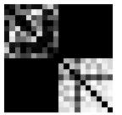
Visualizing a shuffled affinity matrix
If we permute the order of the vertices as they are referred to in the affinity matrix, we see different patterns:
Kristen Grauman

Slide 13
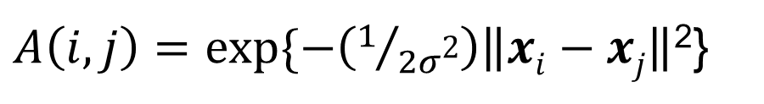
Putting these two aspects together
Points x₁…x₁₀
Data points
Points x₃₁…x₄₀
σ=.1 σ=.2 σ=1
Affinity matrices
$A\left(i,j\right)=exp⁡\{−\left(1/{2σ\text{2}}\right)\left\|xi−xj\right\|$²}
Kristen Grauman

Slide 14
Goal: Segmentation by Graph Cuts
w
A
B
C
Break graph into segments
Delete links that cross between segments
Easiest to break links that have low similarity
similar pixels should be in the same segments
dissimilar pixels should be in different segments
Slide credit: Kristen Grauman

Slide 15
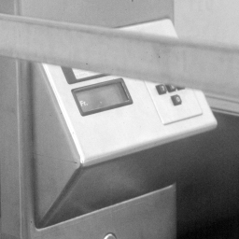
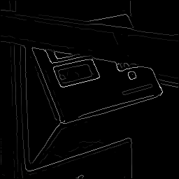
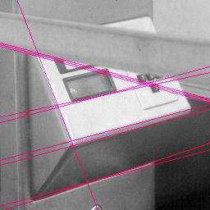
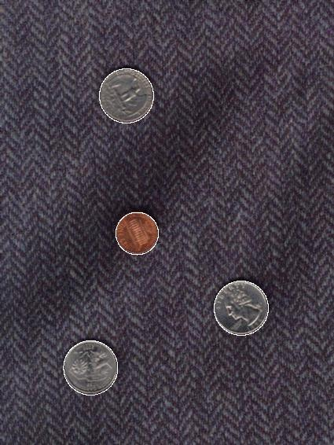
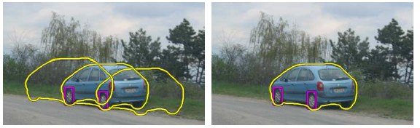
Now: Fitting
Want to associate a model with multiple observed features
[Fig from Marszalek & Schmid, 2007]
For example, the model could be a line, a circle, or an arbitrary shape.
Notes:
We want to form a higher-level, more compact representation of the features in the image by grouping multiple features according to a simple model

Slide 16
Fitting: Main idea
Choose a parametric model that best represents a set of features
Membership criterion is not local
Can’t tell whether a point belongs to a given model just by looking at that point
Three main questions:
What model represents this set of features best?
Which of several model instances gets which feature?
How many model instances are there?
Computational complexity is important
It is infeasible to examine every possible set of parameters and every possible combination of features
Slide credit: L. Lazebnik

Slide 17
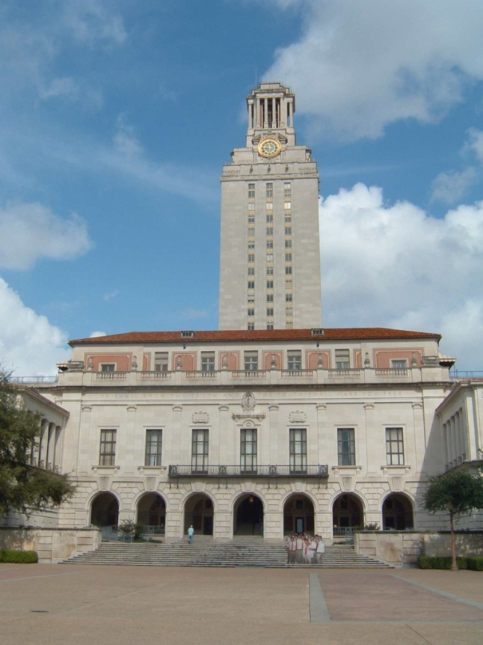
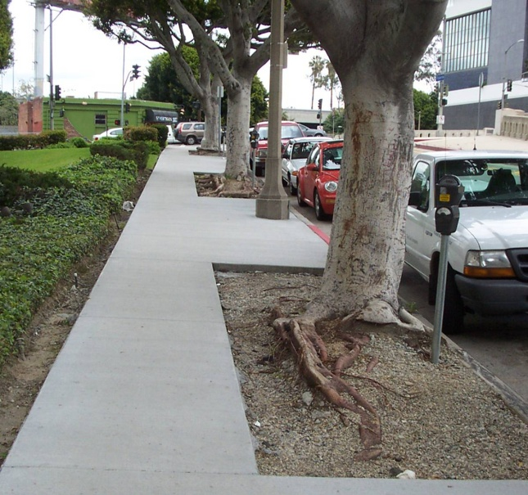
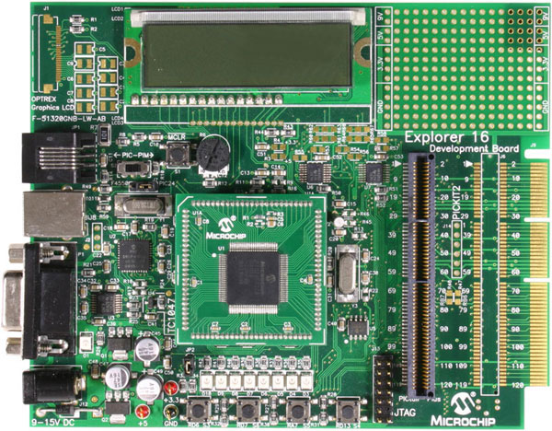
Example: Line fitting
Why fit lines?
Many objects characterized by presence of straight lines
Wait, why aren’t we done just by running edge detection?
Kristen Grauman

Slide 18
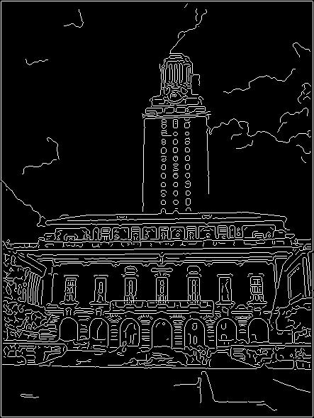
Difficulty of line fitting
Extra edge points (clutter), multiple models:
which points go with which line, if any?
Only some parts of each line detected, and some parts are missing:
how to find a line that bridges missing evidence?
Noise in measured edge points, orientations:
how to detect true underlying parameters?
Kristen Grauman

Slide 19
Voting
It’s not feasible to check all combinations of features by fitting a model to each possible subset.
Voting is a general technique where we let each feature vote for all models that are compatible with it.
Cycle through features, cast votes for model parameters.
Look for model parameters that receive a lot of votes.
Noise & clutter features will cast votes too, but typically their votes should be inconsistent with the majority of “good” features.
Kristen Grauman

Slide 20
Fitting lines: Hough transform
Given points that belong to a line, what is the line?
How many lines are there?
Which points belong to which lines?
Hough Transform is a voting technique that can be used to answer all of these questions.
Main idea:
1. Record vote for each possible line on which each edge point lies.
2. Look for lines that get many votes.
Kristen Grauman

Slide 21
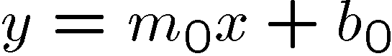
Finding lines in an image: Hough space
Equation of a line?
y = mx + b
y
b
b₀
x
m₀
m
image space
Hough (parameter) space
Connection between image (x,y) and Hough (m,b) spaces
A line in the image corresponds to a point in Hough space
To go from image space to Hough space:
given a set of points (x,y), find all (m,b) such that y = mx + b
Slide credit: Steve Seitz

Slide 22
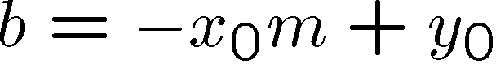
Finding lines in an image: Hough space
y
b
y₀
x₀
x
m
image space
Hough (parameter) space
Connection between image (x,y) and Hough (m,b) spaces
A line in the image corresponds to a point in Hough space
To go from image space to Hough space:
given a set of points (x,y), find all (m,b) such that y = mx + b
What does a point (x₀, y₀) in the image space map to?
Answer: the solutions of b = -x₀m + y₀
this is a line in Hough space
Slide credit: Steve Seitz

Slide 23
Finding lines in an image: Hough space
y
b
(x₁, y₁)
y₀
(x₀, y₀)
b = –x₁m + y₁
x₀
x
m
image space
Hough (parameter) space
What are the line parameters for the line that contains both (x₀, y₀) and (x₁, y₁)?
It is the intersection of the lines b = –x₀m + y₀ and b = –x₁m + y₁
Slide credit: Kristen Grauman

Slide 24
Finding lines in an image: Hough algorithm
y
b
x
m
image space
Hough (parameter) space
How can we use this to find the most likely parameters (m,b) for the most prominent line in the image space?
Let each edge point in image space vote for a set of possible parameters in Hough space
Accumulate votes in discrete set of bins; parameters with the most votes indicate line in image space.
Slide credit: Kristen Grauman

Slide 25
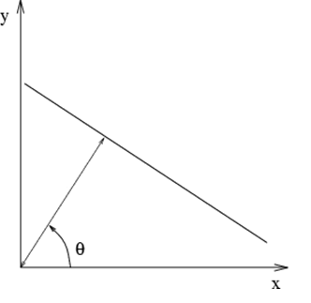
Polar representation for lines
Issues with usual (m,b) parameter space: can take on infinite values, undefined for vertical lines.
: perpendicular distance from line to origin
: angle the perpendicular makes with the x-axis
Point in image space → sinusoid segment in Hough space
Adapted from Kristen Grauman

Slide 26
Hough line demo

Slide 27
Hough transform algorithm
Using the polar parameterization:
Basic Hough transform algorithm
Initialize H[d, θ]=0
for each edge point I[x,y] in the image
for θ = [θ_{min} to θ_{max} ] // some quantization
H[d, θ] += 1
Find the value(s) of (d, θ) where H[d, θ] is maximum
The detected line in the image is given by
H: accumulator array (votes)
d
θ
Time complexity (in terms of number of votes per pt)?
Source: Steve Seitz
Notes:
Num_edge_pts * num_theta

Slide 28
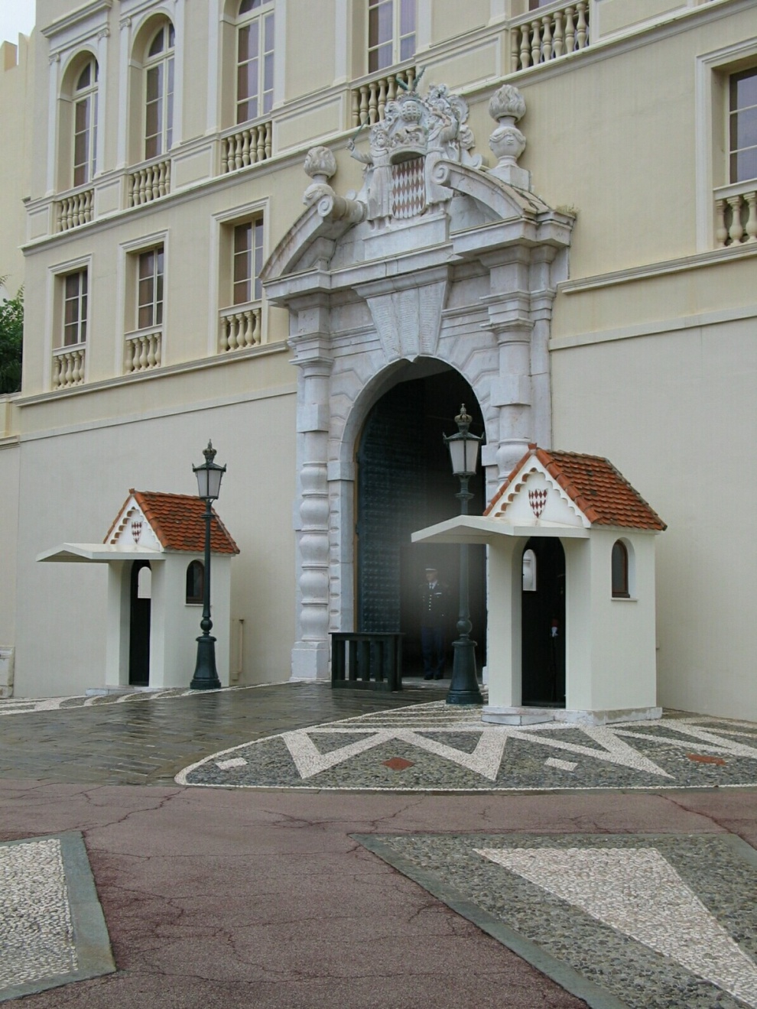
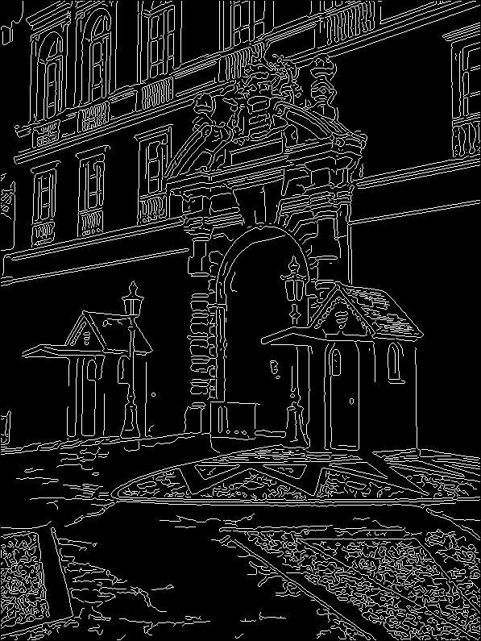
1. Image → Canny
Derek Hoiem

Slide 29
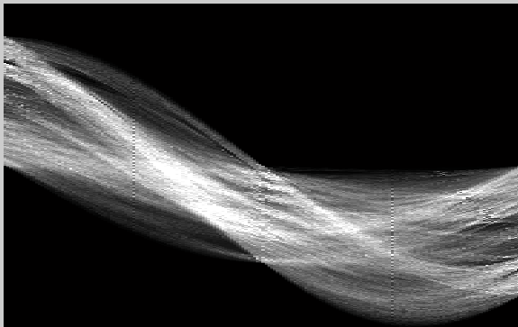
2. Canny → Hough votes
Derek Hoiem

Slide 30
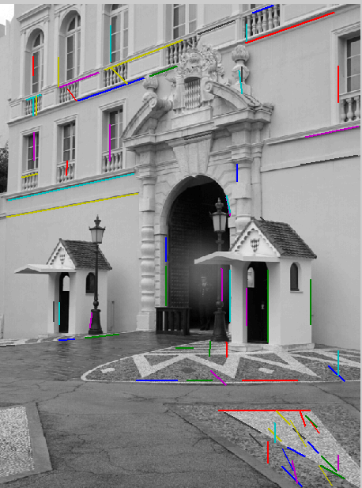
3. Hough votes → Edges
Find peaks
Derek Hoiem

Slide 31
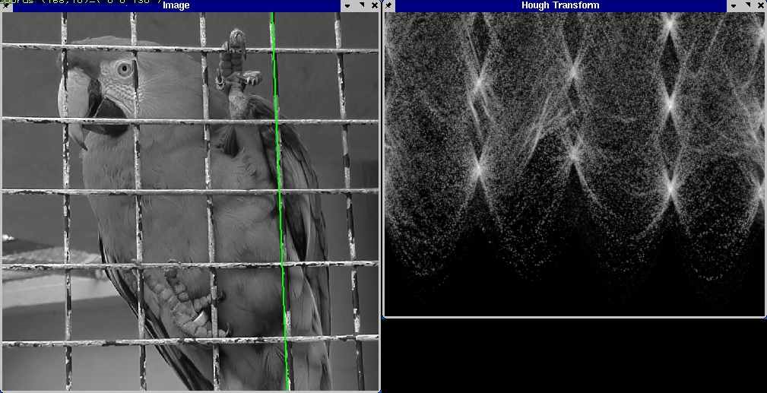
Hough transform example
Derek Hoiem
http://ostatic.com/files/images/ss_hough.jpg

Slide 32
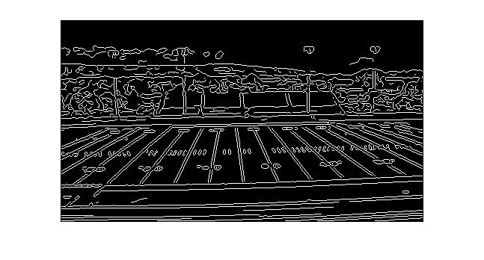
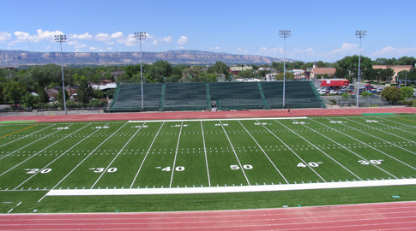
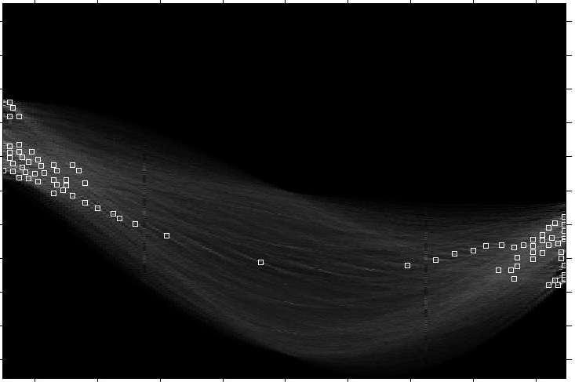
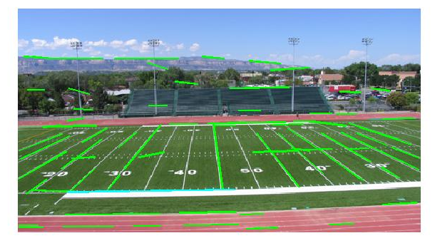
Original image
Canny edges
Vote space and top peaks
Showing longest segments found
Kristen Grauman

Slide 33
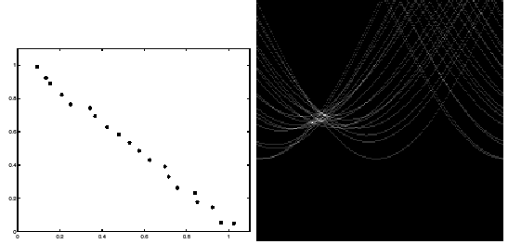
Impact of noise on Hough
y
d
x
θ
Image space
edge coordinates
Votes
What difficulty does this present for an implementation?
Notes:
Quantization errors: an appropriate grid size is difficult to pick.
Need to adjust grid size or smooth

Slide 34
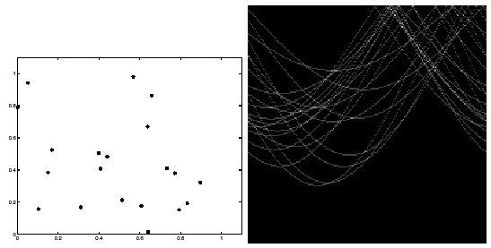
Impact of noise on Hough
Image space
edge coordinates
Votes
Here, everything appears to be “noise”, or random edge points, but we still see peaks in the vote space.
Slide credit: Kristen Grauman
Notes:
possible to find phantom lines

Slide 35

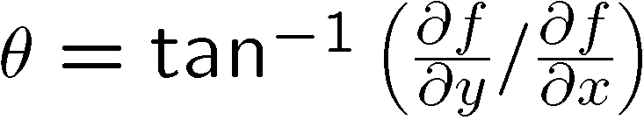
Extensions
Recall: when we detect an edge point, we also know its gradient direction
Extension 1: Use the image gradient
same
for each edge point I[x,y] in the image
θ = gradient at (x,y)
H[d, θ] += 1
same
same
(Reduces degrees of freedom)
Extension 2
give more votes for stronger edges
Extension 3
change the sampling of (d, θ) to give more/less resolution
Extension 4
The same procedure can be used with circles, squares, or any other shape
Slide credit: Kristen Grauman

Slide 36
Extensions
Extension 1: Use the image gradient
same
for each edge point I[x,y] in the image
compute unique (d, θ) based on image gradient at (x,y)
H[d, θ] += 1
same
same
(Reduces degrees of freedom)
Extension 2
give more votes for stronger edges (use magnitude of gradient)
Extension 3
change the sampling of (d, θ) to give more/less resolution
Extension 4
The same procedure can be used with circles, squares, or any other shape…
Source: Steve Seitz

Slide 37
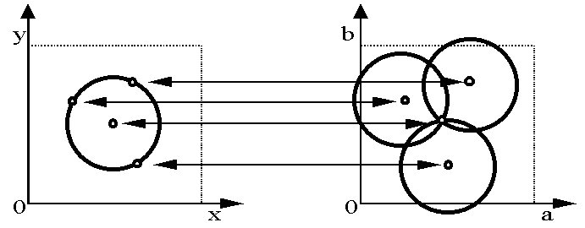
Hough transform for circles
Circle: center (a,b) and radius r
Equation of circle?
For a fixed radius r
Equation of set of circles that all pass through a point?
Image space
Hough space
Adapted by Devi Parikh from: Kristen Grauman

Slide 38
Hough transform for circles
Circle: center (a,b) and radius r
For a fixed radius r
Intersection: most votes for center occur here.
Image space
Hough space
Kristen Grauman

Slide 39
Hough transform for circles
Circle: center (a,b) and radius r
For an unknown radius r
r
?
b
a
Image space
Hough space
Kristen Grauman

Slide 40
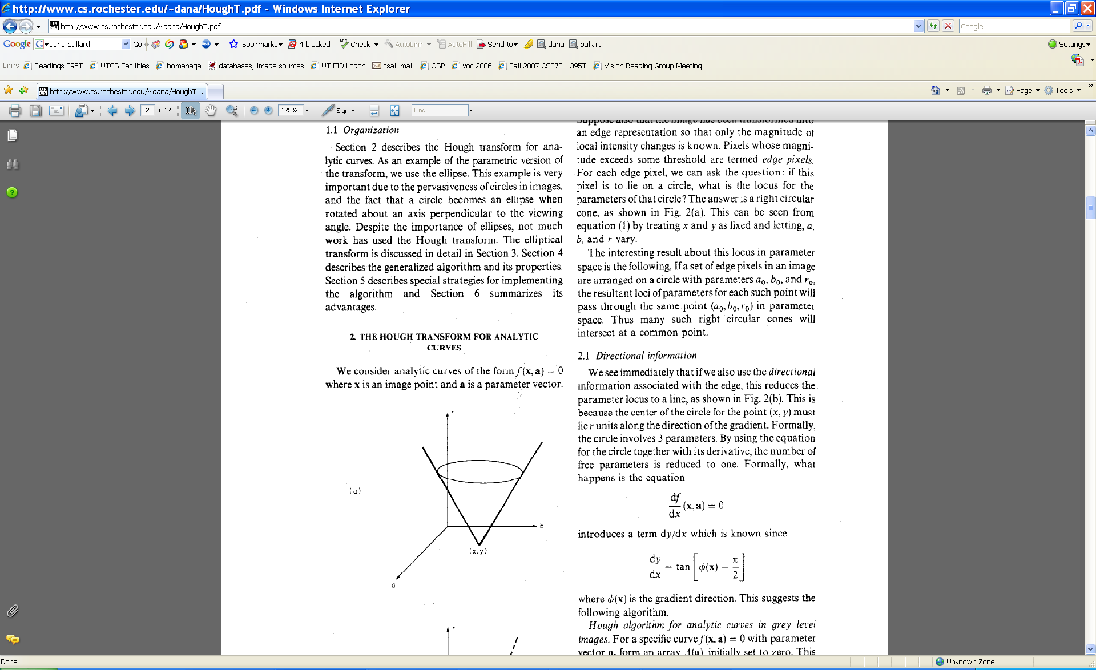
Hough transform for circles
Circle: center (a,b) and radius r
For an unknown radius r
r
b
a
Image space
Hough space
Kristen Grauman

Slide 41
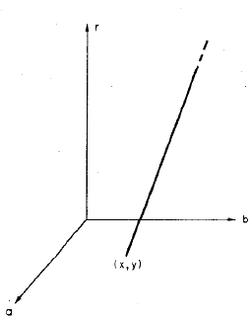
Hough transform for circles
Circle: center (a,b) and radius r
For an unknown radius r, known gradient direction
x
θ
Image space
Hough space
Kristen Grauman

Slide 42
Hough transform for circles
For every edge pixel (x,y) :
For each possible radius value r:
For each possible gradient direction θ:
// or use estimated gradient at (x,y)
a = x – r cos(θ) // column
b = y + r sin(θ) // row
H[a,b,r] += 1
end
end
Time complexity per edge pixel?
Check out online demo : http://www.markschulze.net/java/hough/
Kristen Grauman
Notes:
r*theta
a, b: polar coordinate for circle center

Slide 43
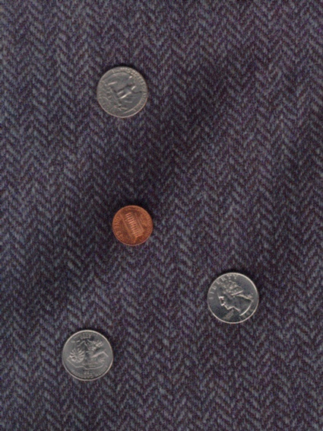
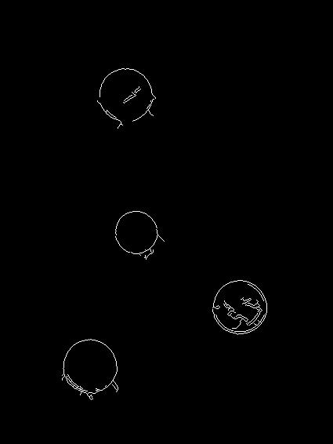
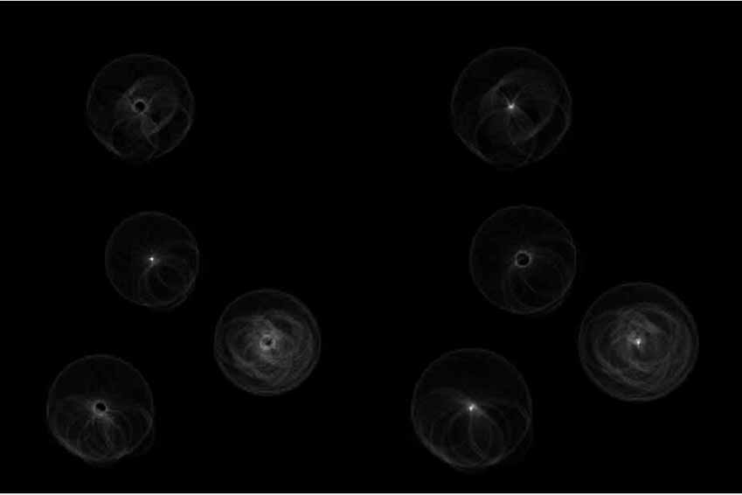
Example: detecting circles with Hough
Original
Edges
Votes: Penny
Note: a different Hough transform (with separate accumulators) was used for each circle radius (quarters vs. penny).
Coin finding sample images from: Vivek Kwatra

Slide 44
Example: detecting circles with Hough
Original
Combined detections
Edges
Votes: Quarter
Coin finding sample images from: Vivek Kwatra

Slide 45
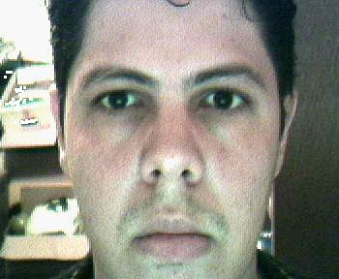
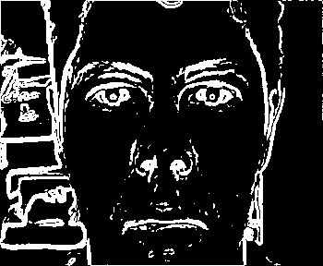
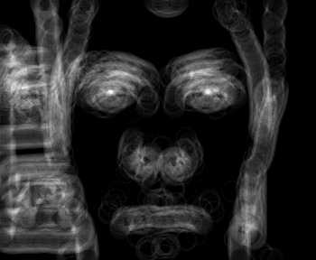

Example: iris detection
Gradient+threshold
Hough space (fixed radius)
Max detections
Hemerson Pistori and Eduardo Rocha Costa http://rsbweb.nih.gov/ij/plugins/hough-circles.html
Kristen Grauman

Slide 46
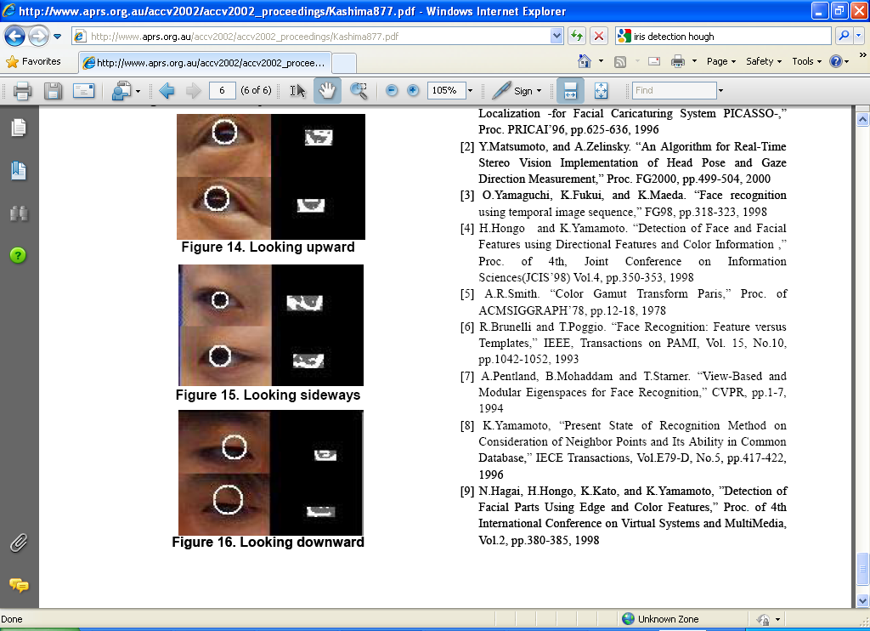
Example: iris detection
An Iris Detection Method Using the Hough Transform and Its Evaluation for Facial and Eye Movement, by Hideki Kashima, Hitoshi Hongo, Kunihito Kato, Kazuhiko Yamamoto, ACCV 2002.

Slide 47
Voting: practical tips
Minimize irrelevant tokens first
Choose a good grid / discretization
Vote for neighbors, also (smoothing in accumulator array)
Use direction of edge to reduce parameters by 1
Too fine
?
Too coarse
Kristen Grauman

Slide 48
Hough transform: pros and cons
Pros
All points are processed independently, so can cope with occlusion, gaps
Some robustness to noise: noise points unlikely to contribute consistently to any single bin
Can detect multiple instances of a model in a single pass
Cons
Complexity of search time increases exponentially with the number of model parameters
Non-target shapes can produce spurious peaks in parameter space
Quantization: can be tricky to pick a good grid size
Kristen Grauman

Slide 49
Generalized Hough Transform
What if we want to detect arbitrary shapes?
Intuition:
Displacement vectors
x
x
x
Ref. point
x
x
Model image
Novel image
Vote space
Now suppose those colors encode gradient directions…
Kristen Grauman

Slide 50
Generalized Hough Transform
Define a model shape by its boundary points and a reference point.
Offline procedure:
x
a
At each boundary point, compute displacement vector: r = a – p_{i}.
Store these vectors in a table indexed by gradient orientation θ.
θ
θ
p₁
p₂
Model shape
θ
…
θ
…
…
[Dana H. Ballard, Generalizing the Hough Transform to Detect Arbitrary Shapes, 1980]

Slide 51
Generalized Hough Transform
Detection procedure:
x
For each edge point:
Use its gradient orientation θ to index into stored table
Use retrieved r vectors to vote for reference point
x
θ
x
x
x
θ
θ
p₁
θ
θ
Novel image
θ
…
θ
…
…
Assuming translation is the only transformation here, i.e., orientation and scale are fixed.

Slide 52
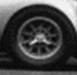
Generalized Hough for object detection
Instead of indexing displacements by gradient orientation, index by matched local patterns.
“visual codeword” with displacement vectors
training image
B. Leibe, A. Leonardis, and B. Schiele, Combined Object Categorization and Segmentation with an Implicit Shape Model, ECCV Workshop on Statistical Learning in Computer Vision 2004
Source: L. Lazebnik

Slide 53

Generalized Hough for object detection
Instead of indexing displacements by gradient orientation, index by “visual codeword”
test image
B. Leibe, A. Leonardis, and B. Schiele, Combined Object Categorization and Segmentation with an Implicit Shape Model, ECCV Workshop on Statistical Learning in Computer Vision 2004
Source: L. Lazebnik

Slide 54
Summary
Fitting problems require finding any supporting evidence for a model, even within clutter and missing features
associate features with an explicit model
Voting approaches, such as the Hough transform, make it possible to find likely model parameters without searching all combinations of features
Hough transform approach for lines, circles, …, arbitrary shapes defined by a set of boundary points, recognition from patches

Slide 55
Questions?
See you Thursday!

